Slide 1
Excercise 2.9: Storytelling with Data Presentations_Task.v01
File created on: 2/12/2023 9:40:51 PM

Slide 2
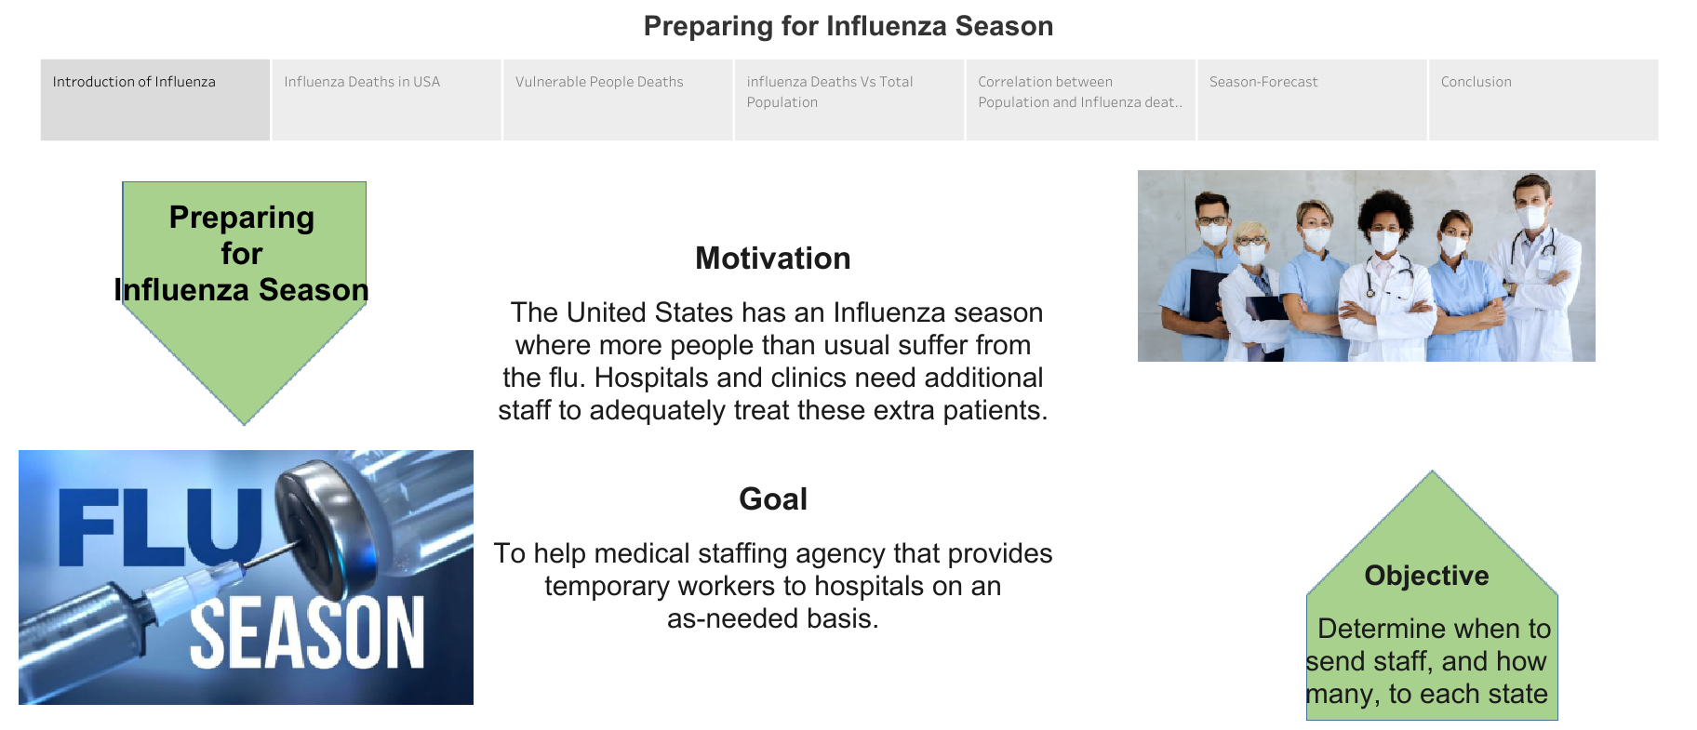

Slide 3
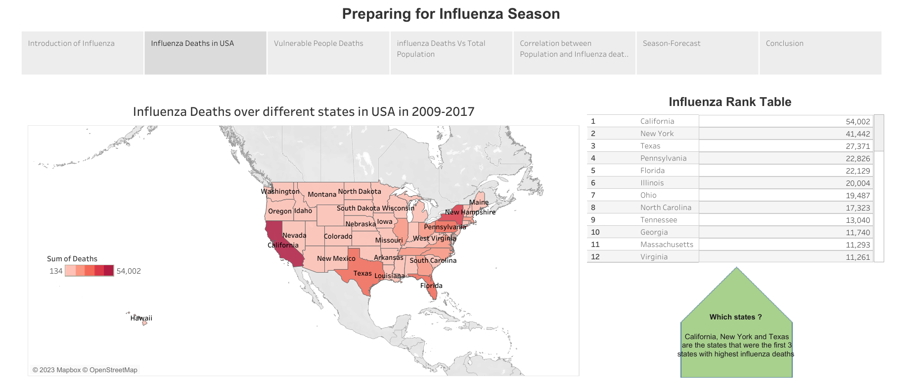

Slide 4
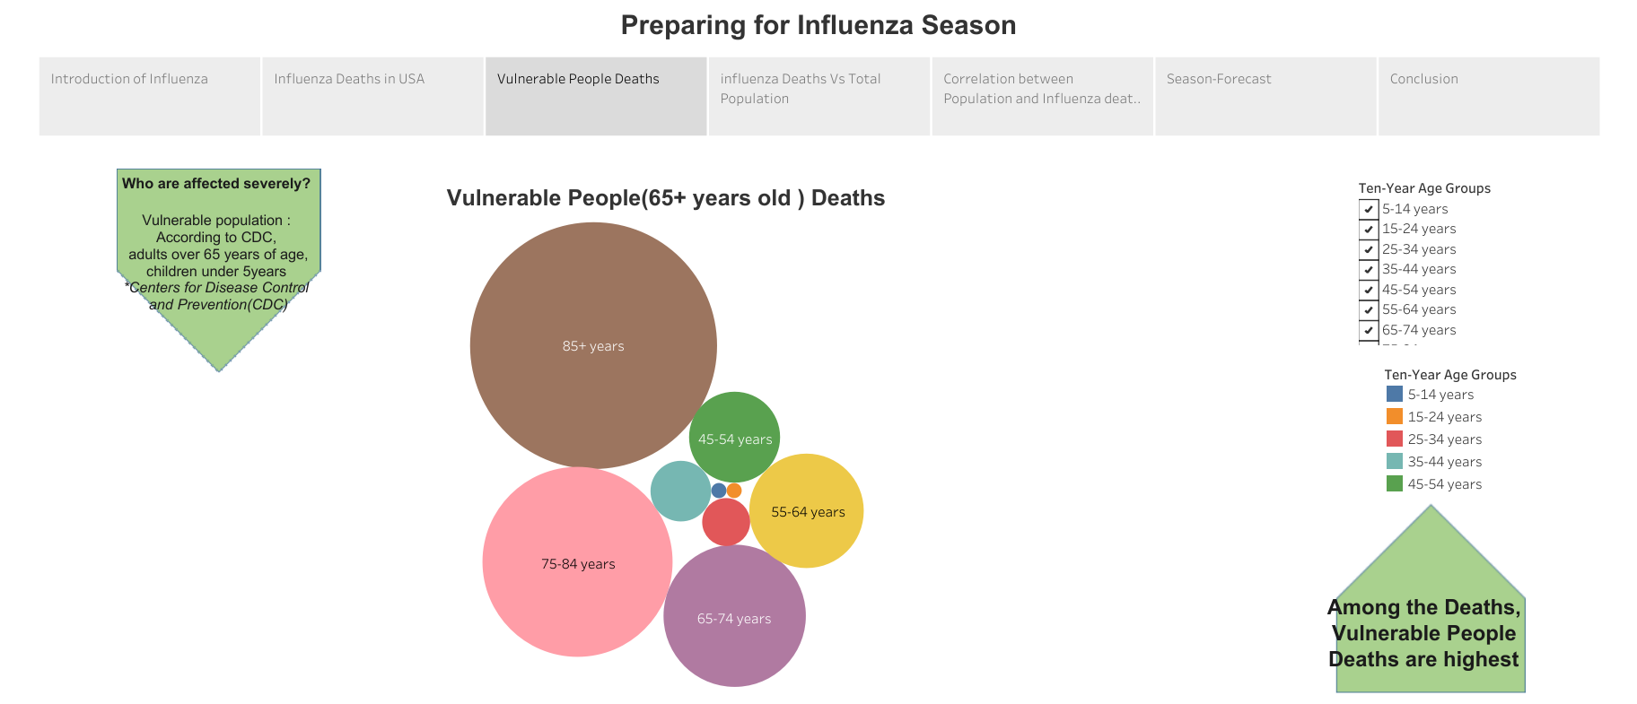

Slide 5
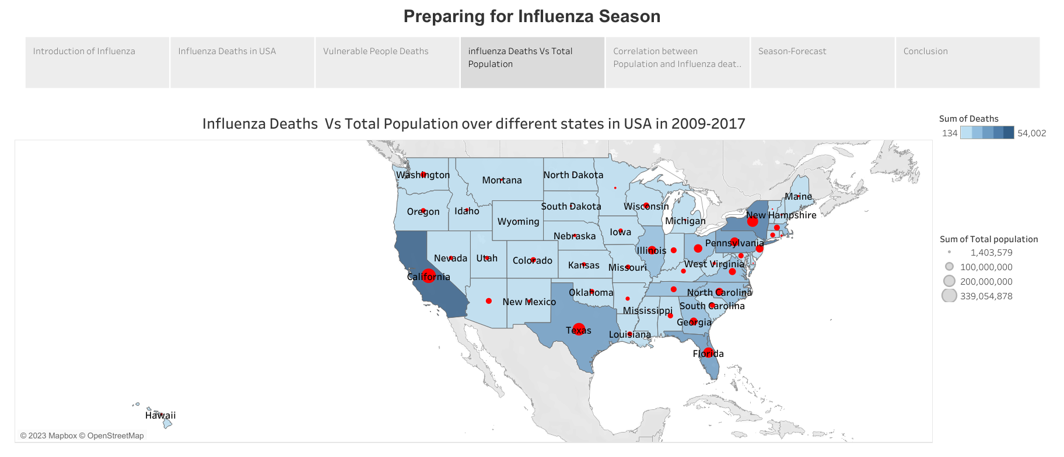

Slide 6
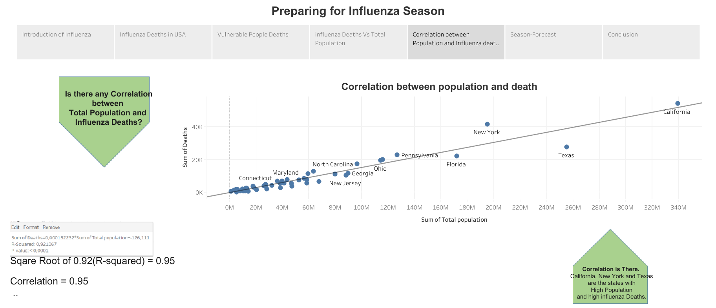

Slide 7
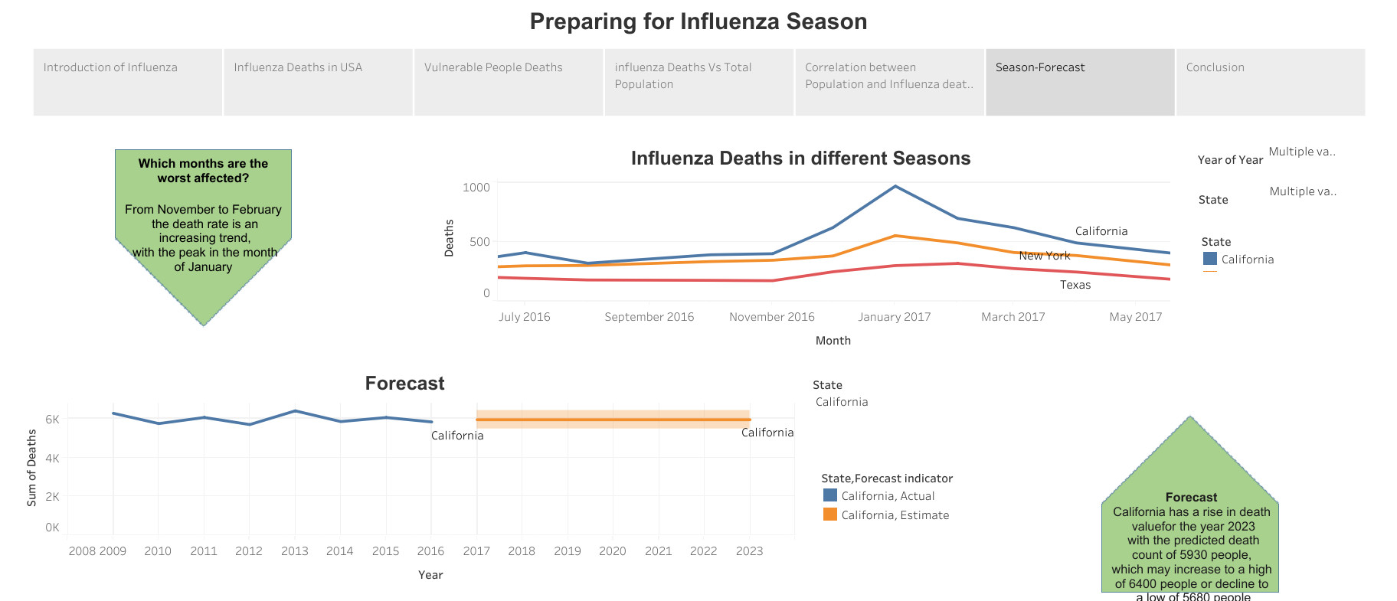

Slide 8
